Slide 1
DEPARTMENT OF PHYSICS
SRM INSTITUTE OF SCIENCE AND TECHNOLOGY
18PYB103J –Semiconductor Physics
Lecture-4
SOLVING PROBLEMS
18PYB103J Module-I Lecture-4

Slide 2
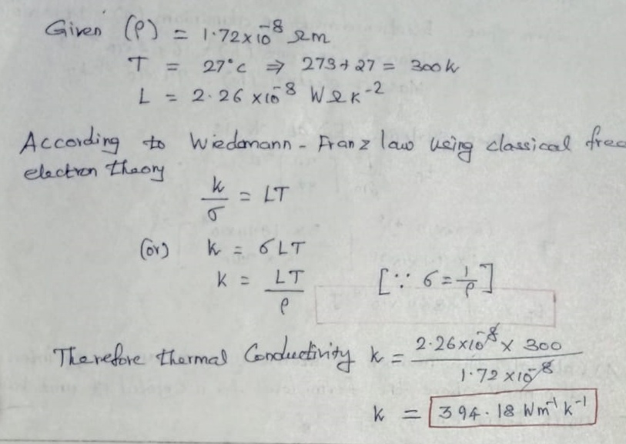
1. The electrical resistivity of copper at 27⁰ C is 1.72 x 10⁻⁸ Ohm m. Compute its thermal conductivity if the Lorentz number is 2. 26 x 10⁻⁸ W Ohm K⁻²
18PYB103J Module-I Lecture-4

Slide 3
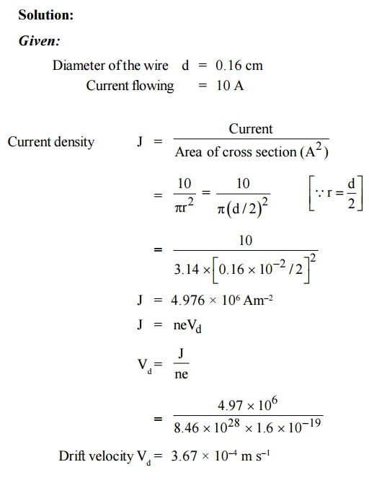
2. Calculate the drift velocity of electrons in copper and current density in wire of diameter 0.16 cm which carries a steady current of 10 A. Given n = 8.46 × 10²⁸ m^{–3}.
18PYB103J Module-I Lecture-4

Slide 4
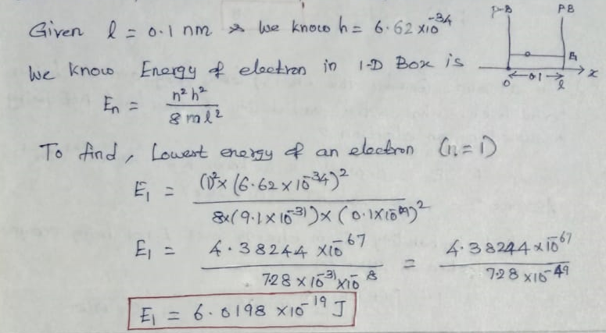
3. Find the lowest energy of an electron confined in one dimensional
potential box separated by distance 0.1 nm.
18PYB103J Module-I Lecture-4

Slide 5
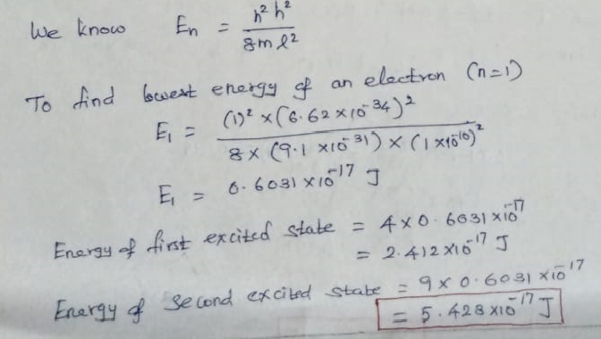
4. An electron is bound in one dimensional infinite well of width 1 x 10⁻¹⁰m. Find the energy value in the ground state, first and second excited states.
18PYB103J Module-I Lecture-4

Slide 6
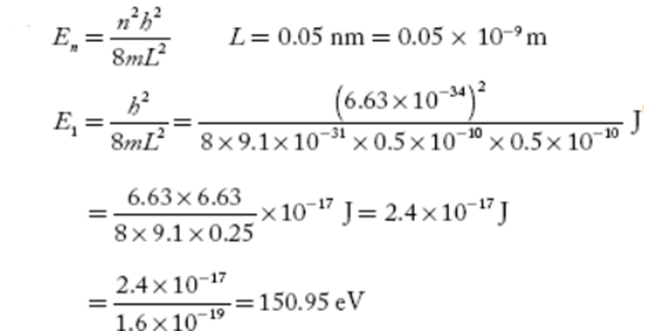
5. Find the least energy of an electron moving in one-dimensional potential box (infinite height) of width 0.05nm.
18PYB103J Module-I Lecture-4

